Slide 1
User Observation Study Results
Isabella Cortez
Prof. Hornof
CS 443: User Interfaces
27 November 2023

Slide 2

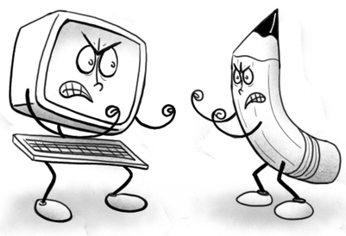
The Question of My Study
Is the computer prototype going to be easier to learn and apply SQ3R than using paper to learn and apply SQ3R?
Reason for testing this question:
The computer prototype could be easier for learning and applying SQ3R because it walks the user through the steps (hand-holding)
Using paper to learn and apply SQ3R to a reading could be easier for retaining information because often times, writing things down helps people remember

Slide 3
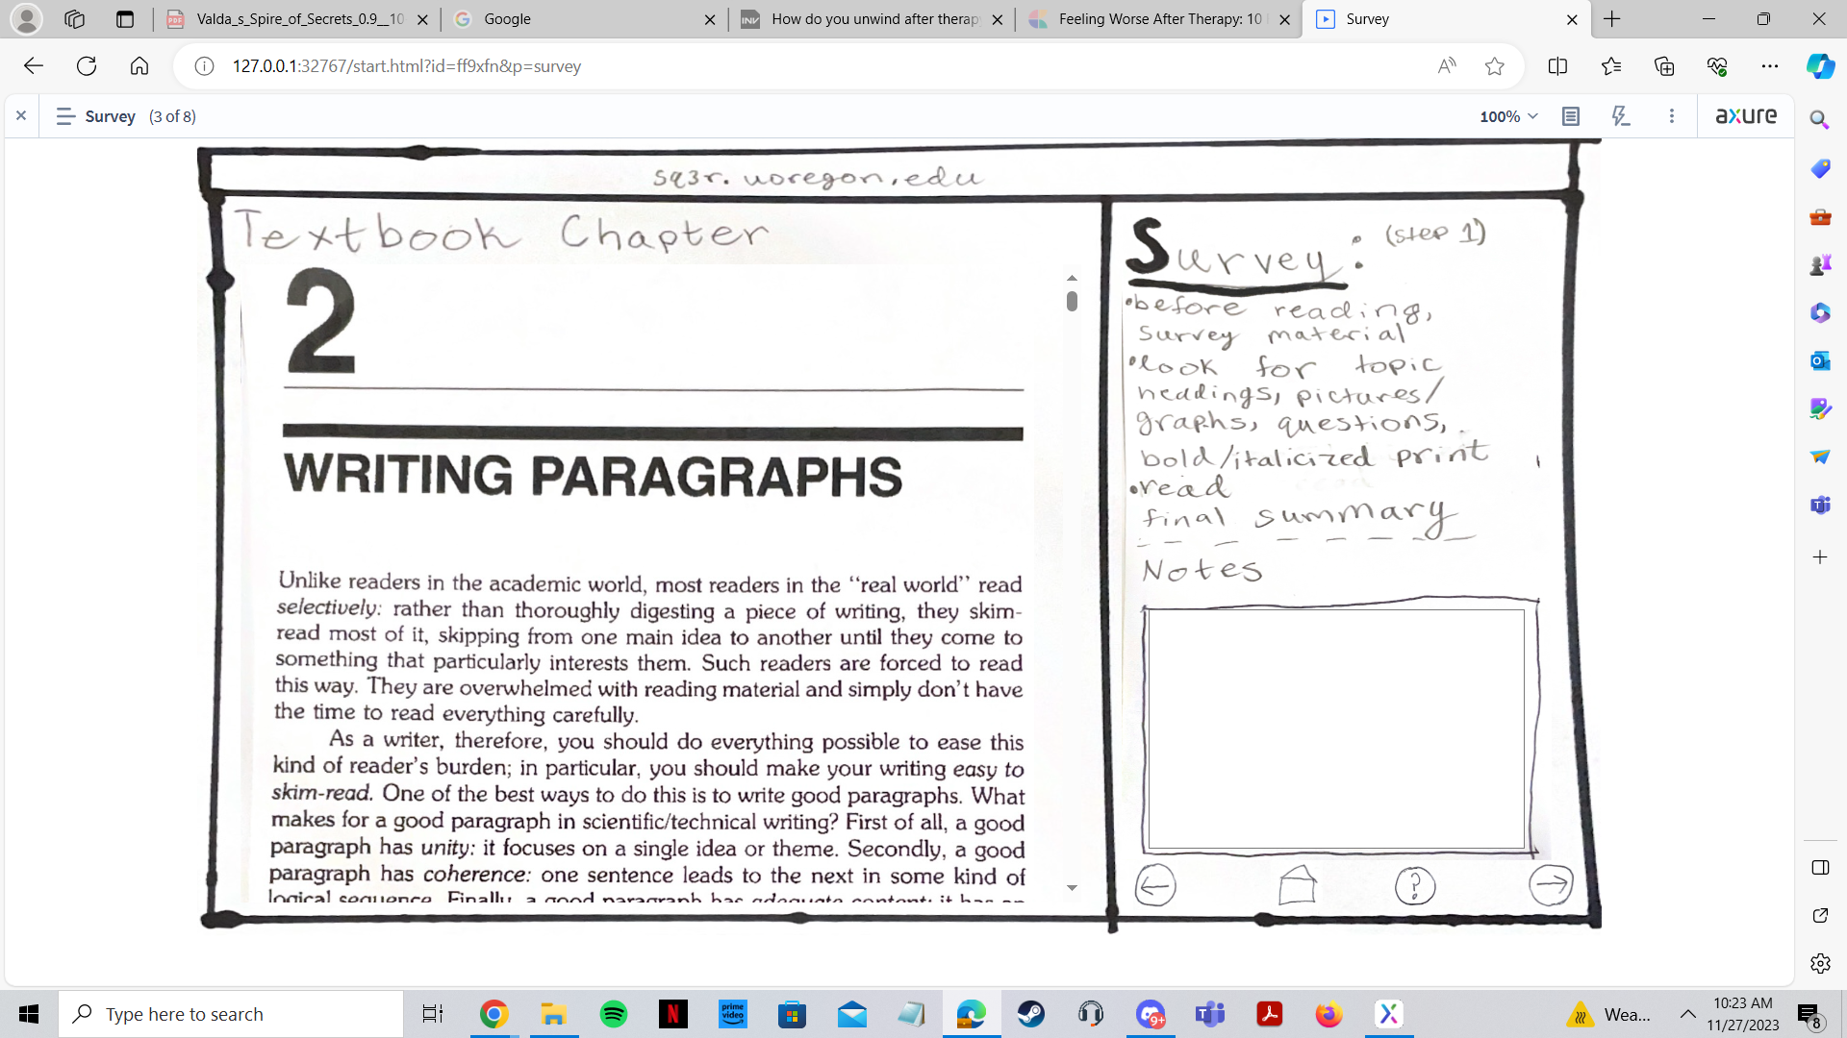
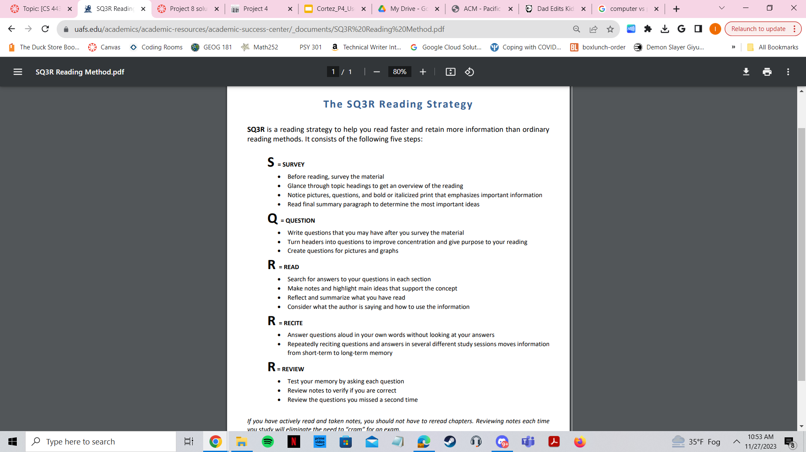
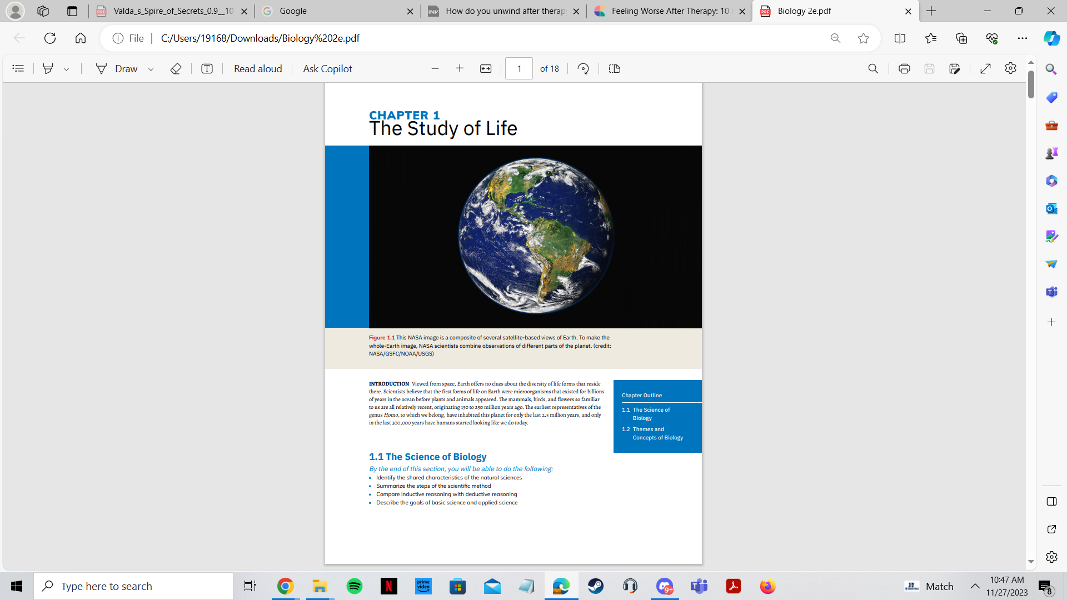
User Interface and Variations
I used the computer system I created in Project 3, which had the Huckin and Olsen, Writing Paragraphs (chapter 2)
I used a paper system which consisted of the SQ3R handout and a printed copy of chapter 1 section 1.1 of the biology textbook

Slide 4

Methodology
4 participants total; introduced myself and explained task
First 2 participants
Did the paper system first, then the computer system
Last 2 participants
Did the computer system first, then the paper system
After each system, there was a 2 question quiz to see what participants learned from the two systems
Debriefing
First two participants
I asked what they thought in general
Both of them self reported that the computer was easier to complete the task being asked because it walked them through the steps
Last two participants
I asked what they thought in general
I asked whether it was more helpful to use the computer or to handwrite since they started off with the computer (and therefore had the walkthrough first)

Slide 5
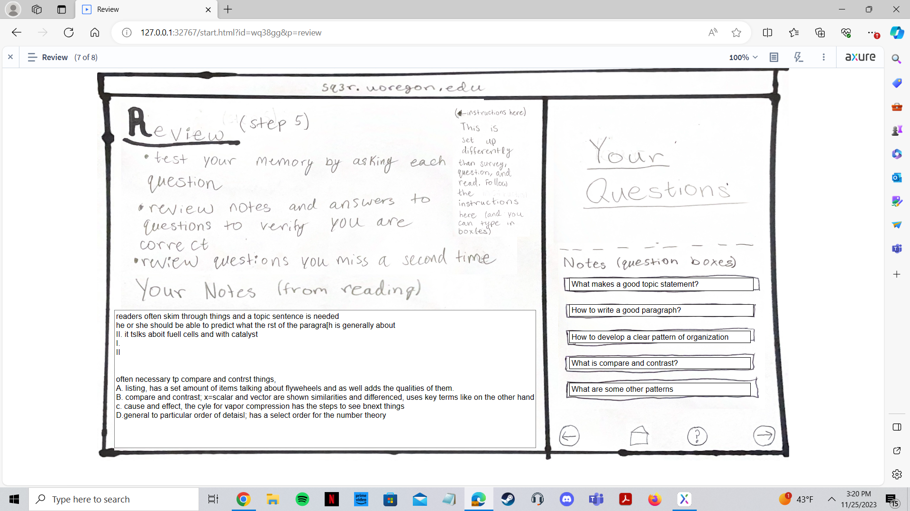
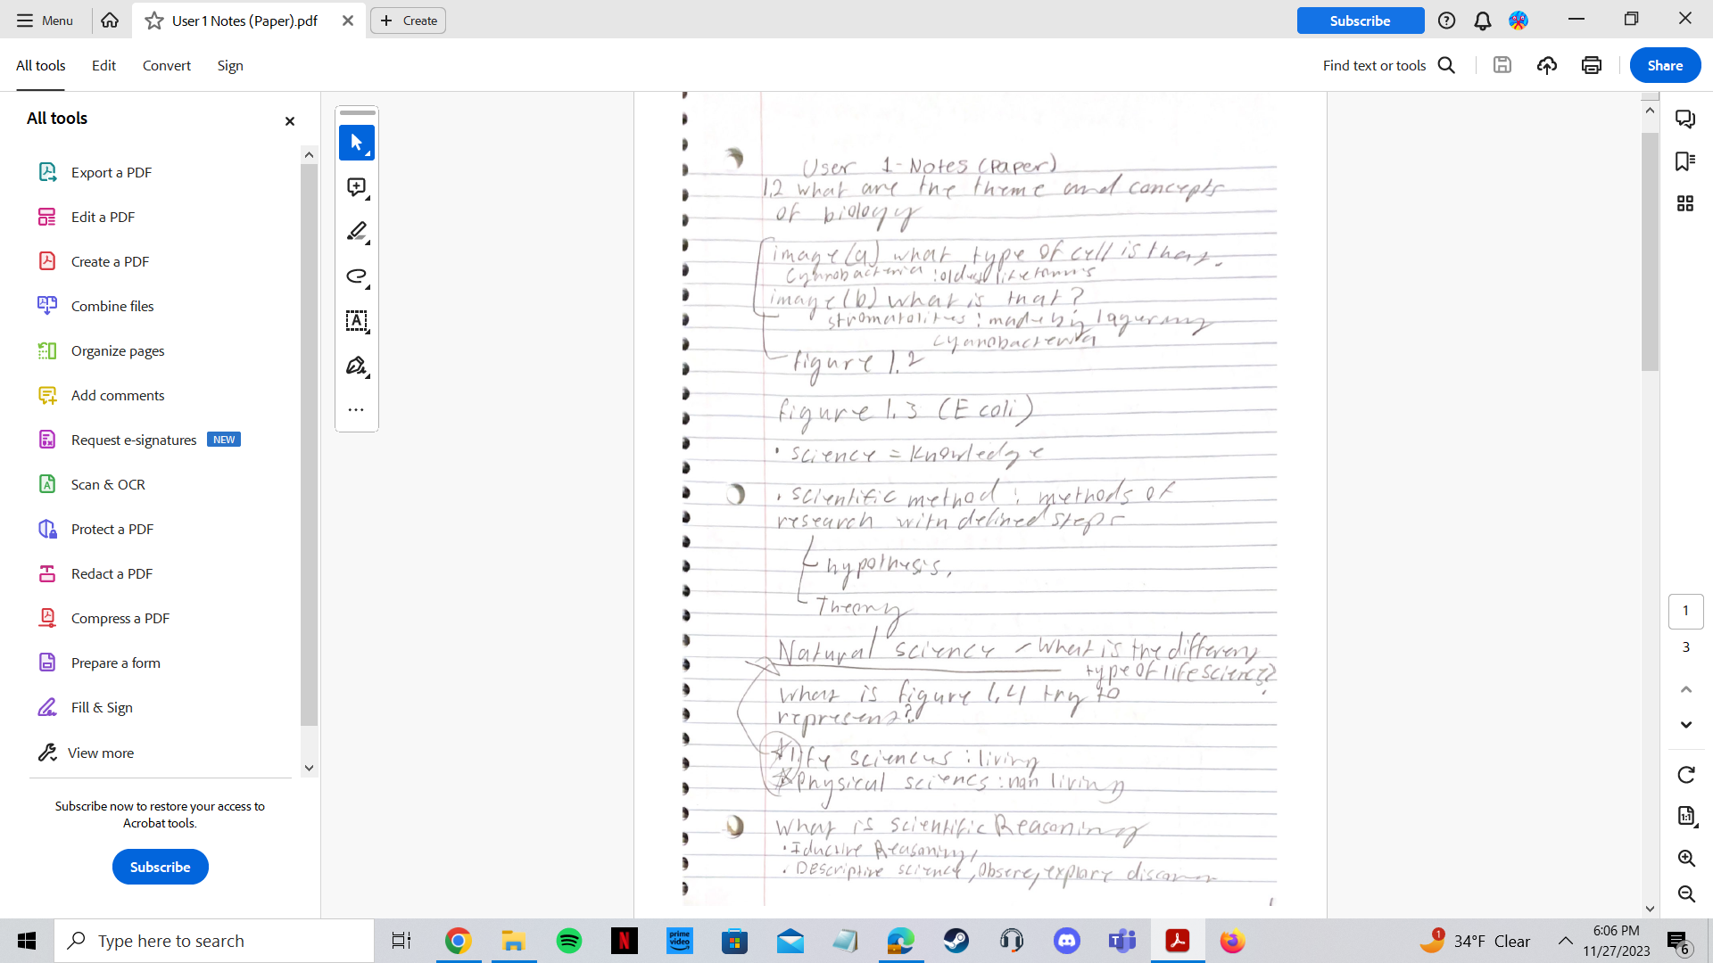
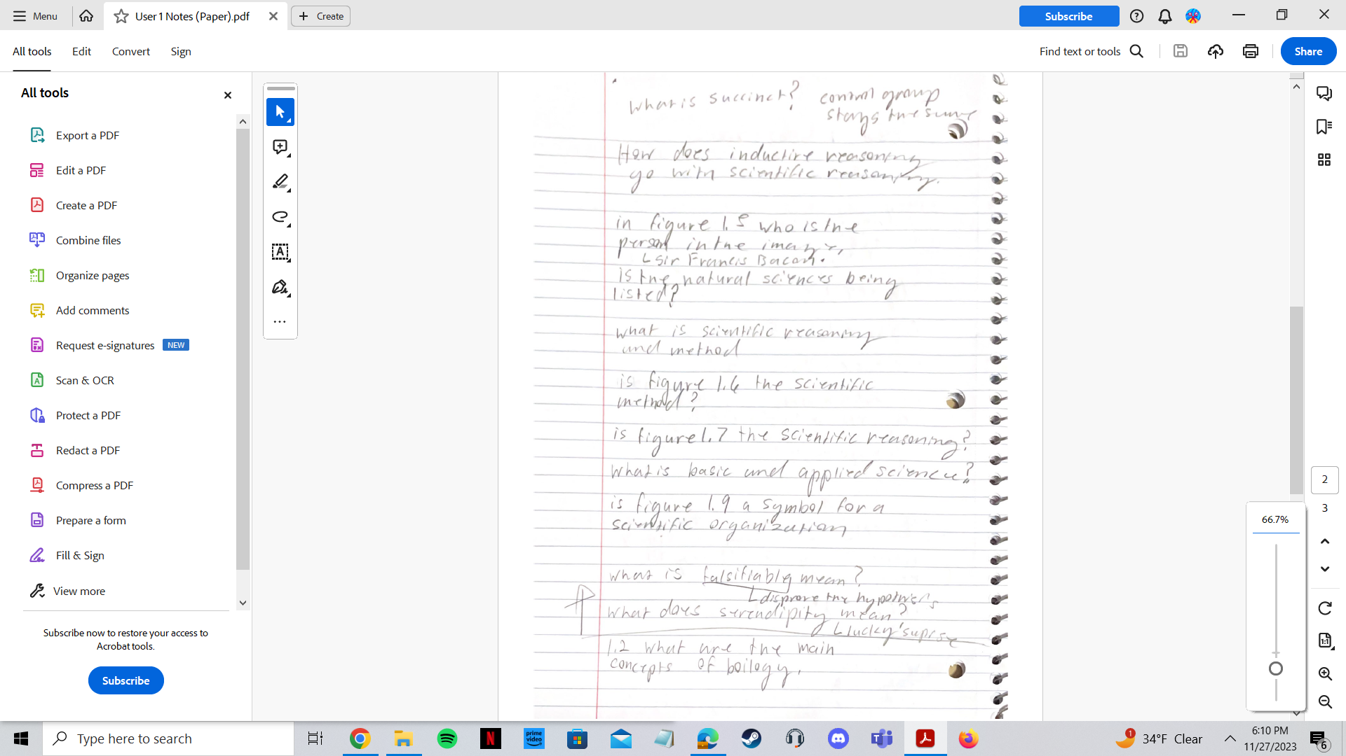
Testing My Question In My Study
To test my question, I gave my users a quiz after each section to test what they understood
I had a quiz for both the computer system and the paper system
I observed how much time it took for my users to complete each task
I observed the quality of notes on paper vs the computer

Slide 6
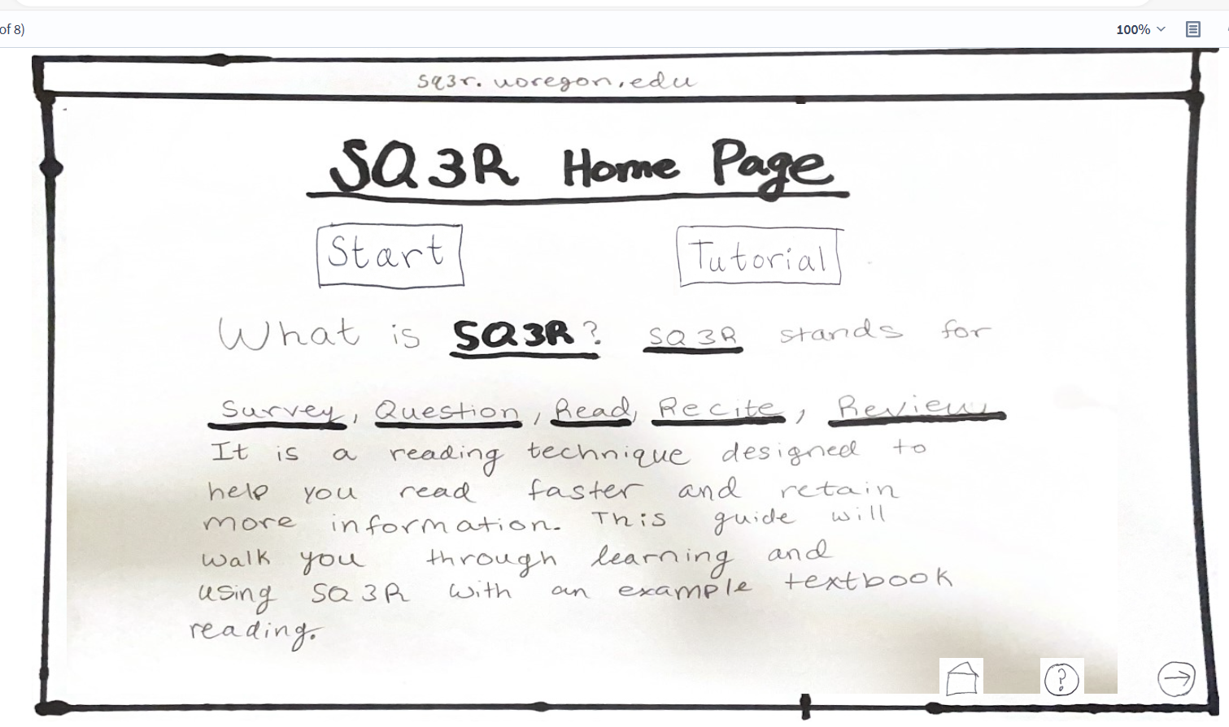
Questions for the Computer System
(the quiz)
What is SQ3R used for?
Reason for including this question:
It was on the first page of the system and I wanted to see how much my participants learned from the title slide of the system
List 5 facts about writing paragraphs that you learned from the reading:
Reason for this question:
I wanted to see how much users understood the writing paragraphs reading

Slide 7
Questions for the Paper System
(the quiz)
What does SQ3R stand for?
Reason for including this question:
I wanted to see how much my participants paid attention to what SQ3R stands for, which was on the handout
List 5 facts about biology that you learned from the reading:
Reason for including this question:
I wanted to see how much users understood chapter 1, section 1.1 of the biology textbook reading

Slide 8
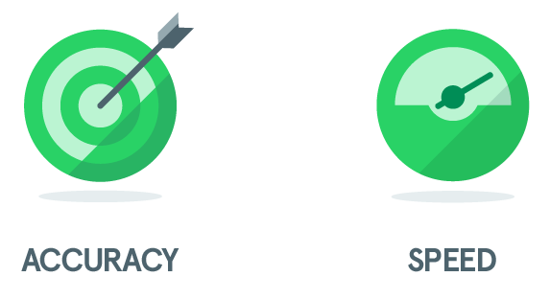
Data
Speed
The first two participants in my study took an hour to do each task, therefore 4 hours total
The last two participants in my study took about 20 minutes to do each task, therefore about 40 minutes total
Accuracy
The first two participants who took longer, were more accurate with their answers (understanding of SQ3R and understanding of the readings)
The last two participants who took less time on each task, were less accurate with their answers (understanding of SQ3R and understanding of the readings)
The last two participants found it easier on a laptop because we do assignments on laptops, therefore it was easier to do and easier not to type as much
Easier to retain information when handwritten

Slide 9
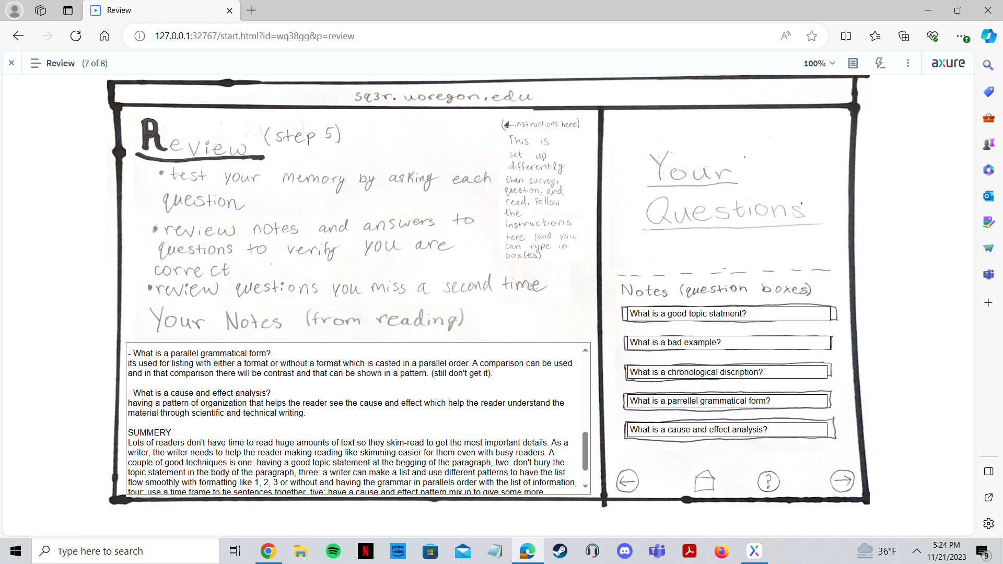
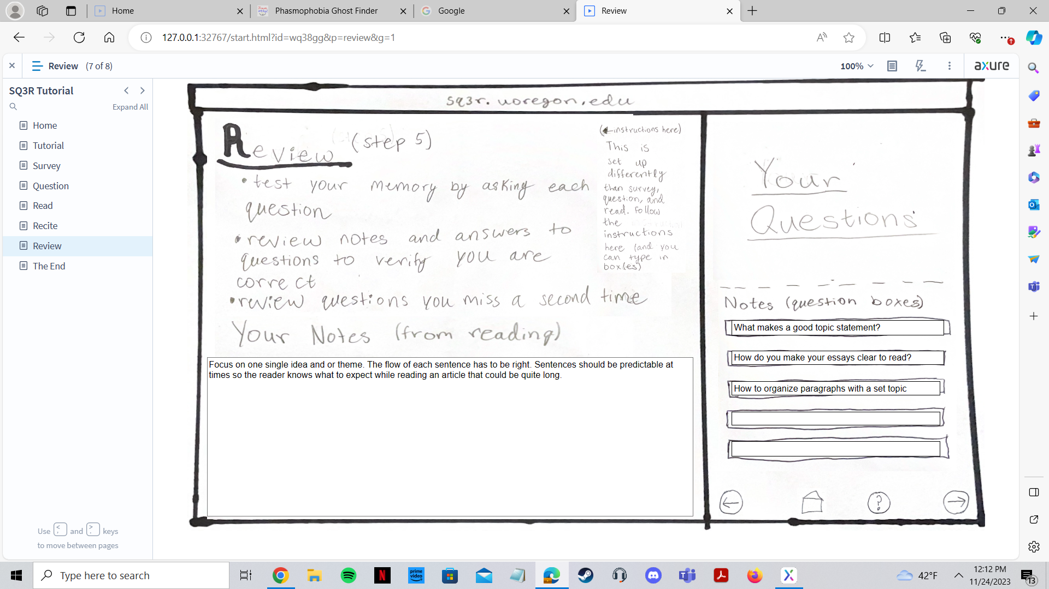
Data in Depth - Speed (computer)
Examples of what participants typed for their notes
On computer system
User 1: time on computer trial: 1 hour; total time: 2 hours
User 3: time on computer trial: 18 minutes; total time: 45 minutes

Slide 10
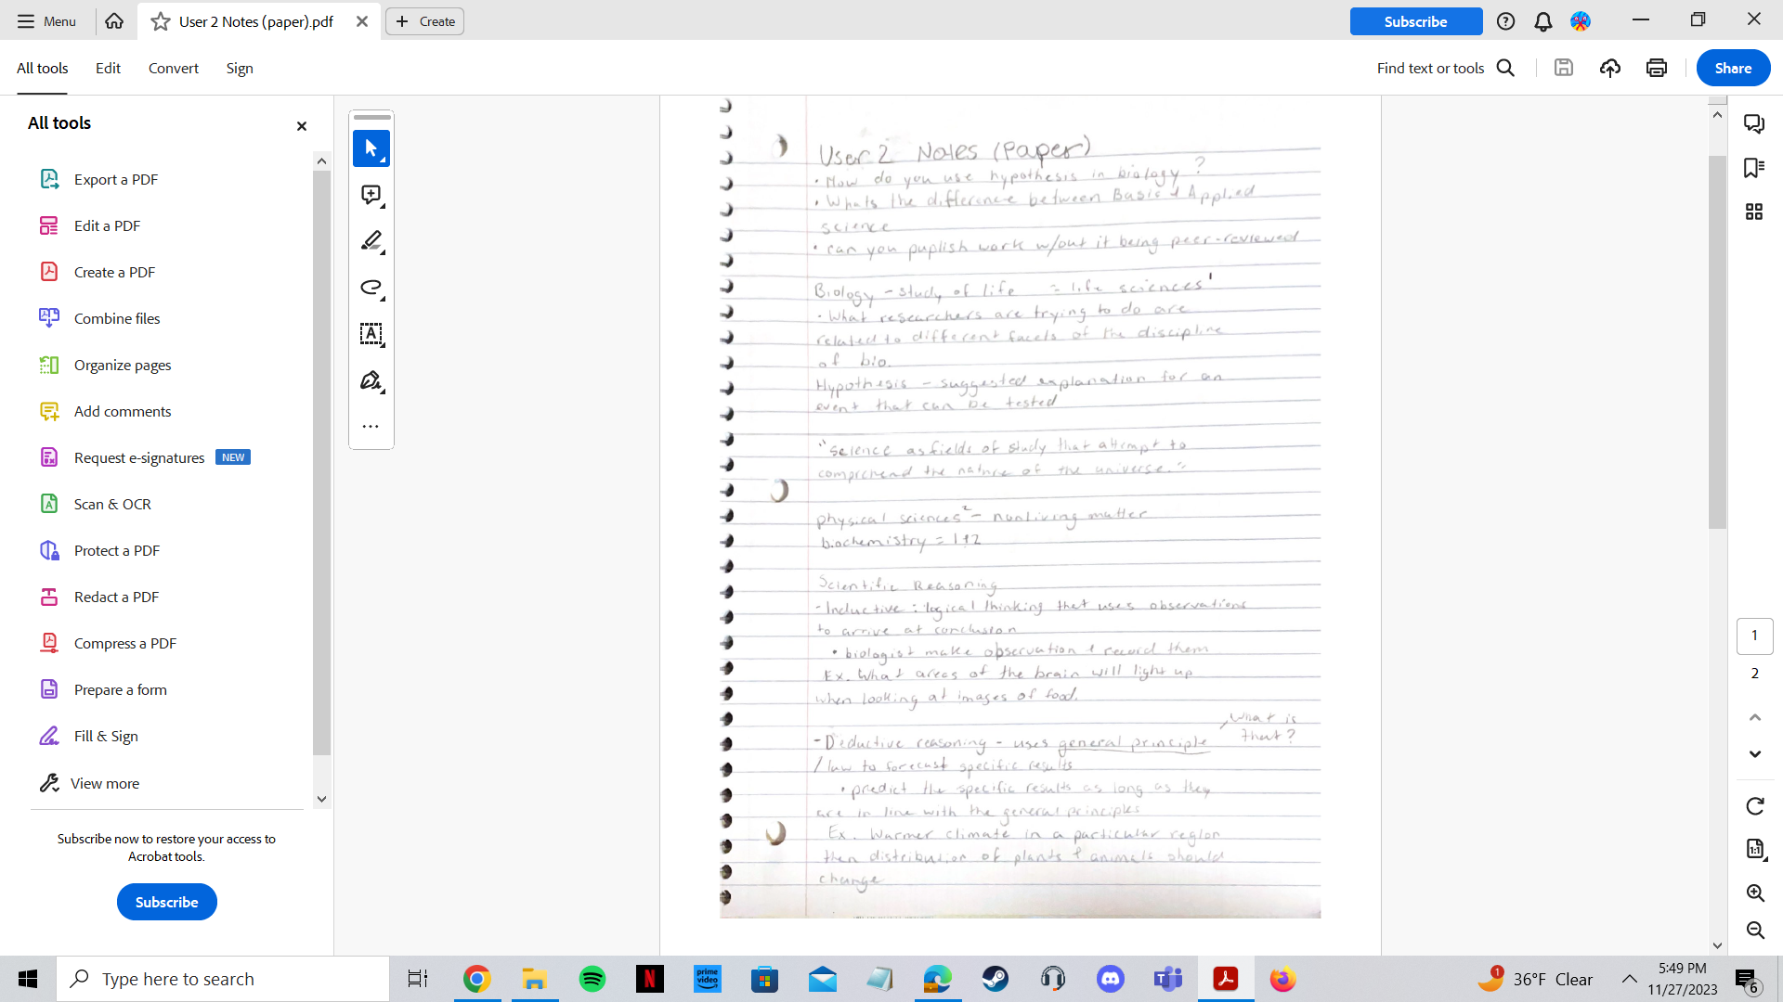
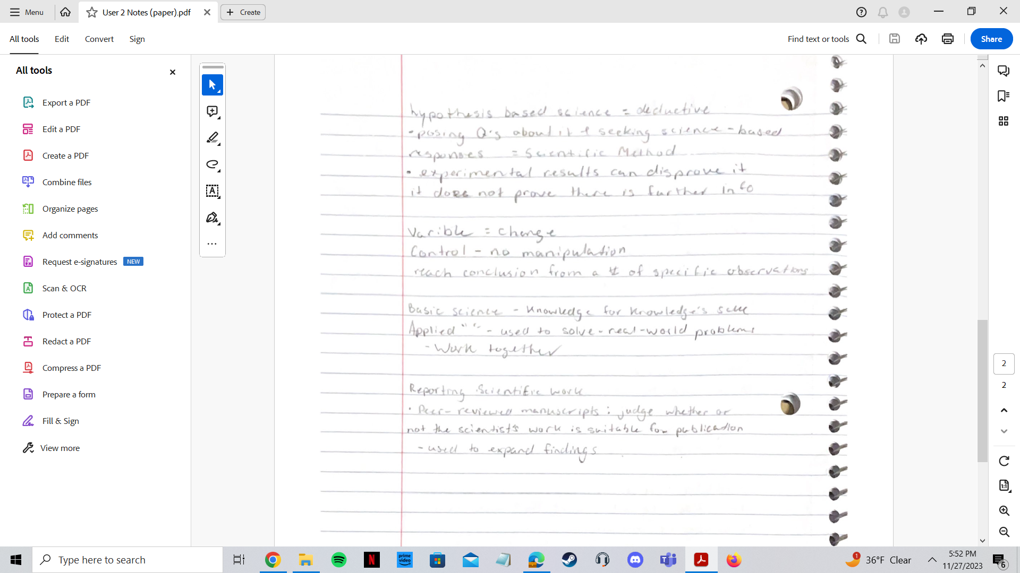
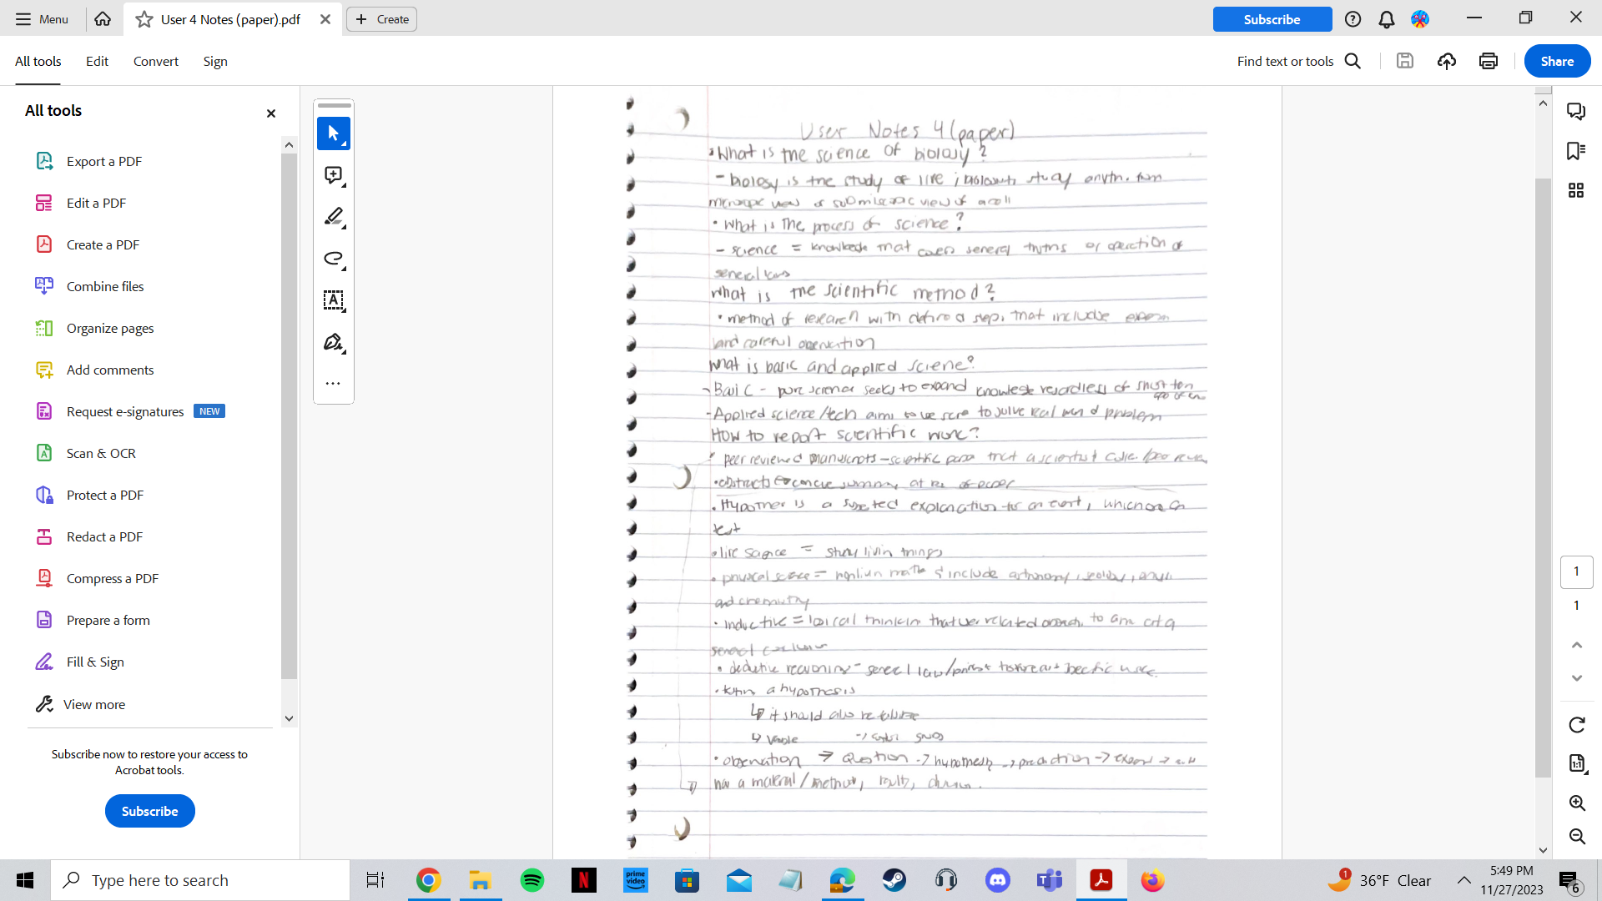
Data in Depth - Speed (paper)
Examples of what participants typed for their notes
On paper system
User 2: time on paper trial: 1 hour; total time: 2 hours
User 4: time on computer trial: 25 minutes; total time: 50 minutes

Slide 11
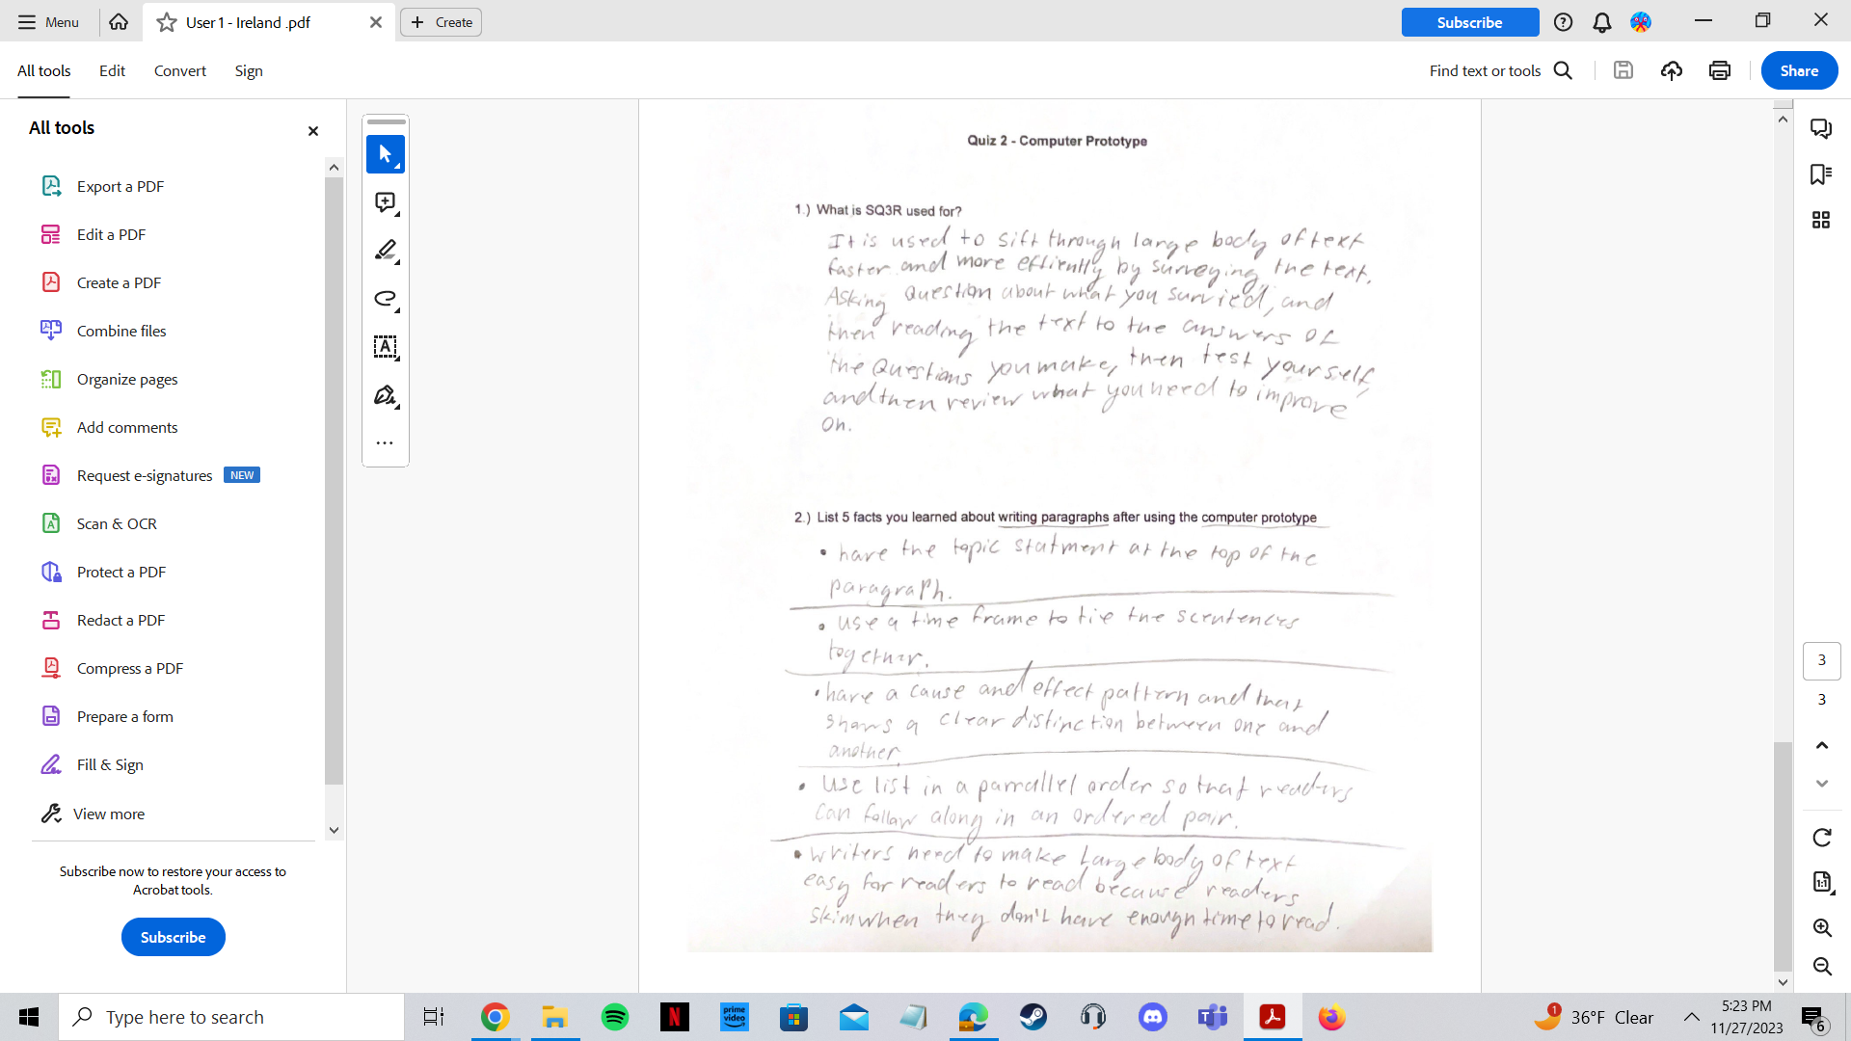

Data in Depth - Accuracy (computer)
Examples of what participants wrote for the quiz
After the participants went through the computer system
< User 1: quiz response
User 3: quiz response >

Slide 12
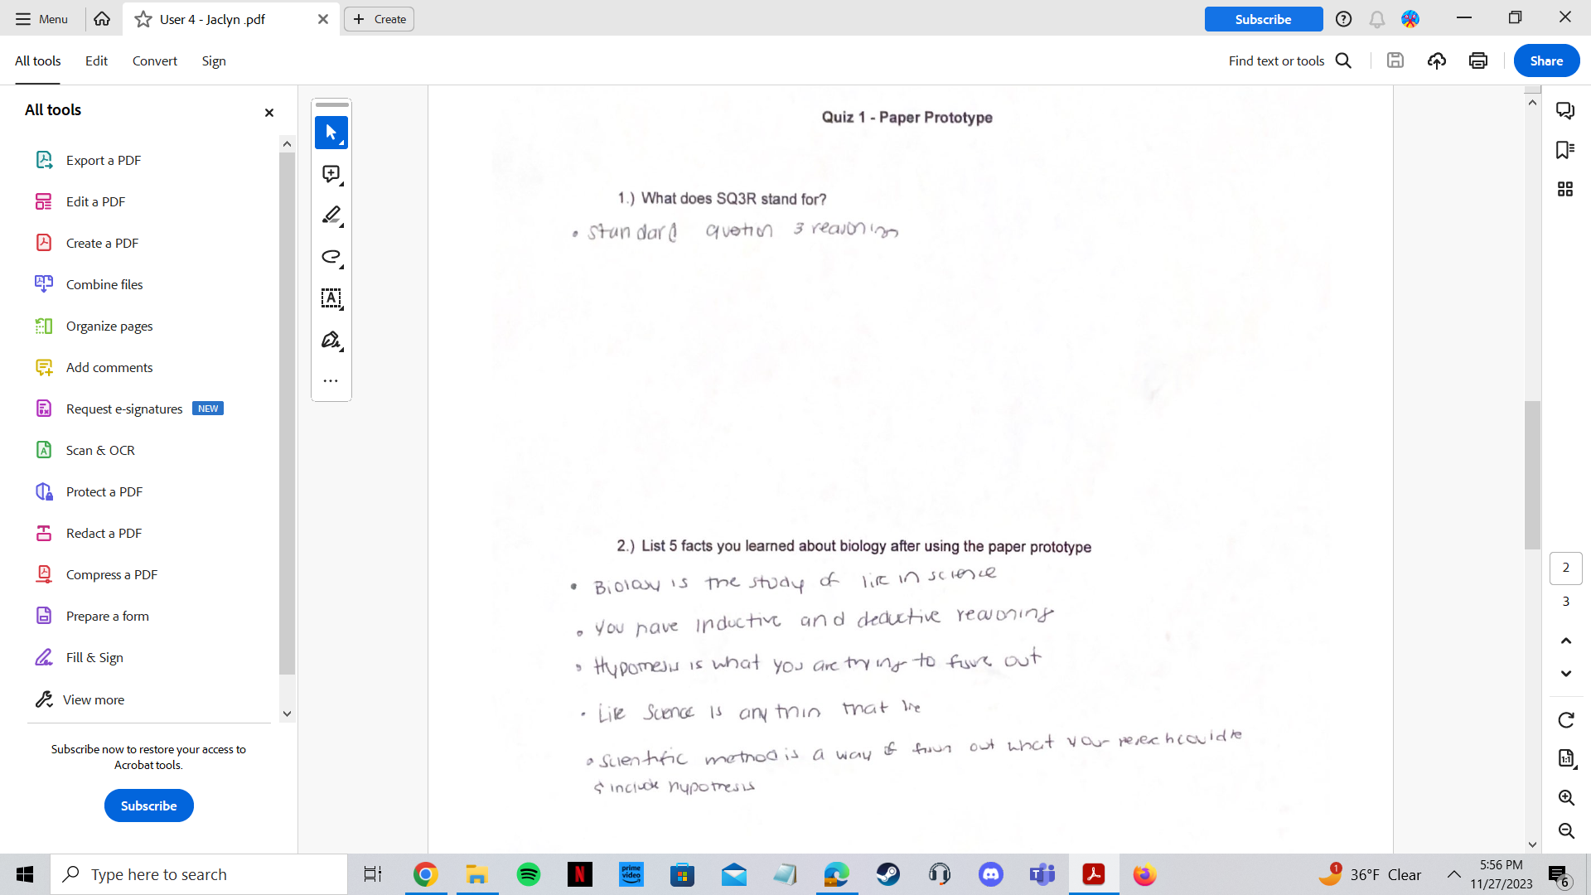
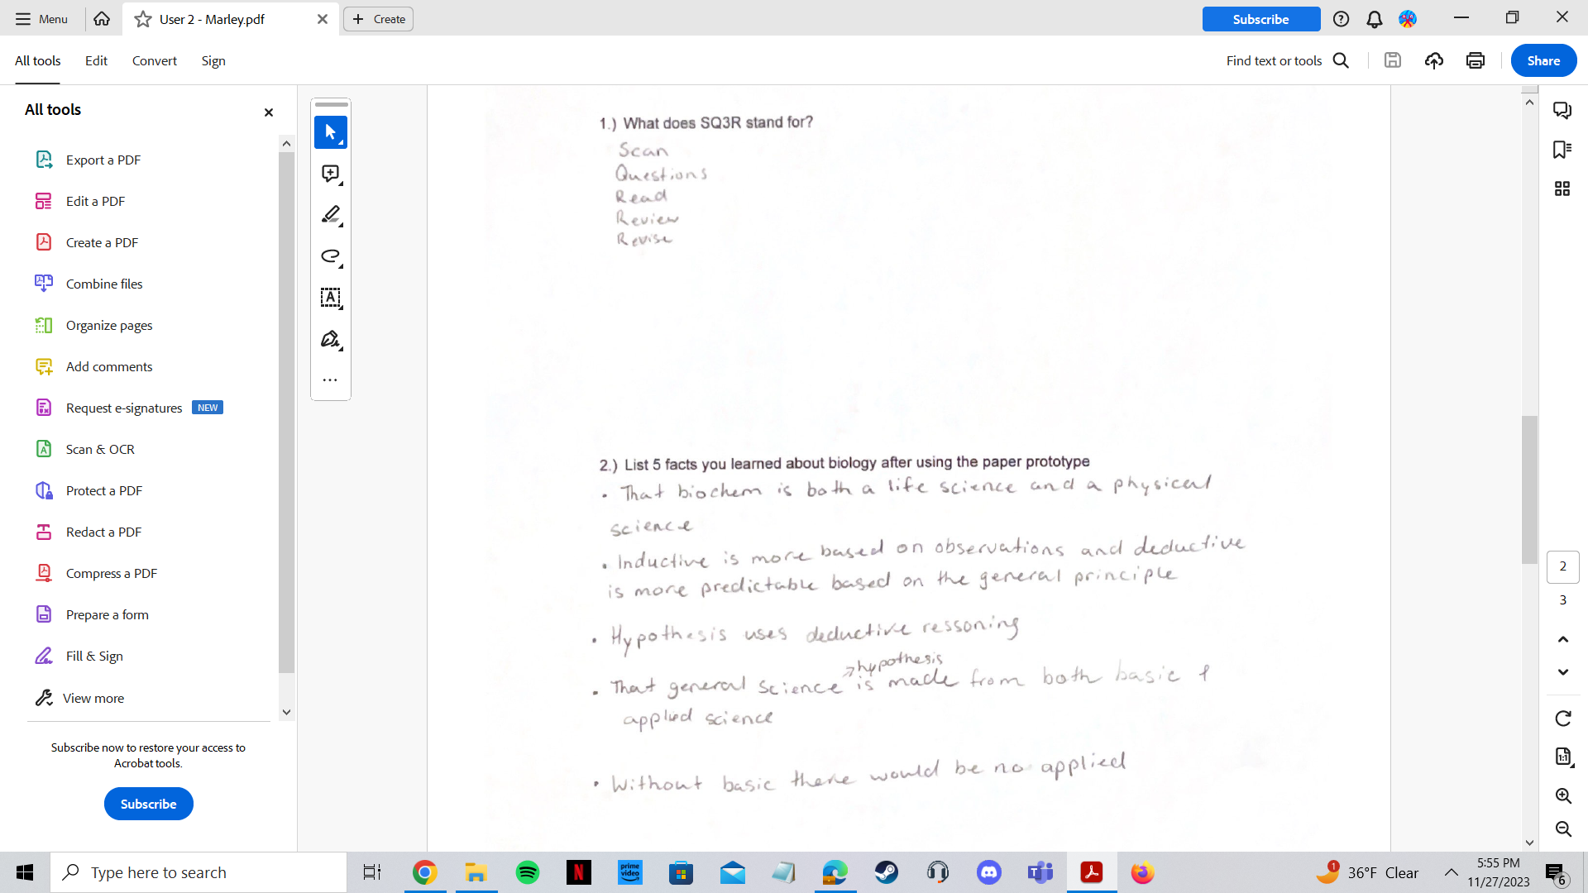
Data in Depth - Accuracy (paper)
Examples of what participants wrote for the quiz
After the participants went through the paper system
< User 2: quiz response
User 4: quiz response >

Slide 13

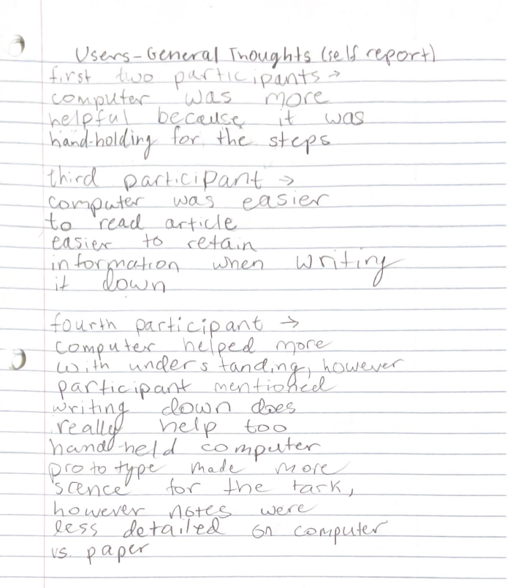
Conclusions
Both systems are helpful or useful to people (not one or the other)
For someone who does not know what SQ3R is, it is easier to start with a computer system because that is a walk through both learning and applying SQ3R
The walk through makes it easier to learn and apply SQ3R both on a paper and computer
Even though it is easier to go through the system on the computer, doing SQ3R by hand makes it easier to remember information
Time is a factor

